Slide 1

KING’S COUNTY
HOUSES PRICING PLAN
Data Science Graduation Project/ Orange Coding Academy

Slide 2

Our team :
Toqa Akram Ghneimat
Hassan Alnobani
Ahmed Alshawabkeh

Slide 3
CONTENTS OF OUR PRESENTATION :
Problem statement and Objective.
Dealing with the extracted features.
Feature selection, Columns and variables we studied.
Models we used.
Random Forest and Gradient Boosting for modeling.
Hyperparameter tuning
Best Model Evaluation.
User facing webPage.

Slide 4
Introduction
Given the dataset that records the houses price in King County Washington, US. The house prices are recorded along with some other features like number of bedrooms, number of bathrooms, area of the house etc.
The Goal is to use this data to explore the factors on which the price depends and build a model which will be able to predict the price of the house based on the related features.

Slide 5
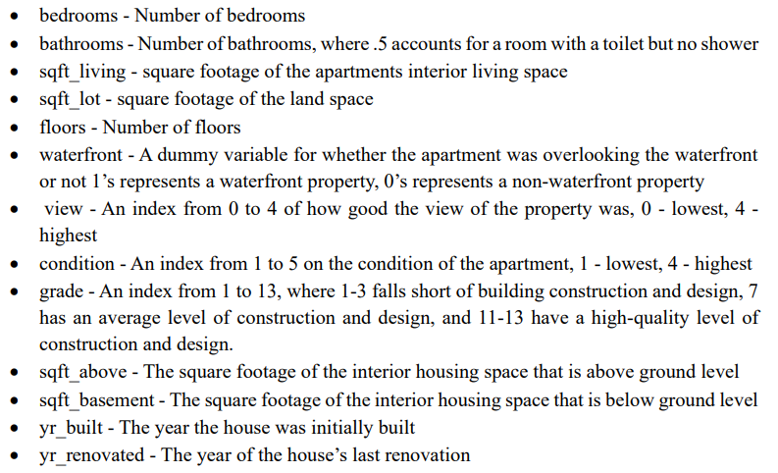
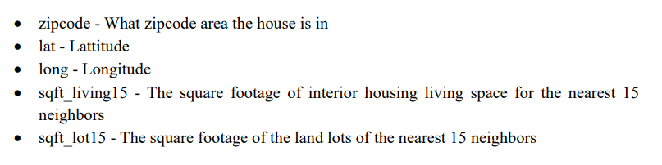
Description of the data
Our Data Contains 21,613 Houses and 21 Columns (20 features and one target).

Slide 6

1. OUR BUSINESS STATEMENT (FROM “PURCHASE POWER” TO “PRICE”)
Purchase
Power
Regression
Model
Price
We had first studied the “purchase power” which we measured by the time interval between building a house and selling it, and how all the factors and variables affected that time interval.
But as we studied the data further, we were facing some issues like the lack of some important features and information we need to create our prediction model, because -as we all know- this data is created for the study purpose and it is just experimental.
So, our study and model, house’s price prediction, based on a dataset of about 20,000 of houses in the United States, King county. Depending on various features.

Slide 7
1.1 Handling Outliers
1- Identifying Outliers using Interquartile Range (IQR)
In this section, we discuss a method for identifying outliers in a specific column using the Interquartile Range (IQR) method.
It creates a mask "outlier_mask" that will contain True values for data points in the columns that are considered outliers based on the IQR method.
2- Outlier Handling with RobustScaler:
To handle outliers in our dataset effectively, we applied a technique called RobustScaler.
RobustScaler is a preprocessing method that scales numerical features while being robust to the presence of outliers. This helps in handling outliers by making the data less sensitive to extreme values.
In summary, the code first identifies outliers in columns using the IQR method, creating a Boolean mask to flag outlier rows and then , scales numeric columns to handle outliers using RobustScaler

Slide 8
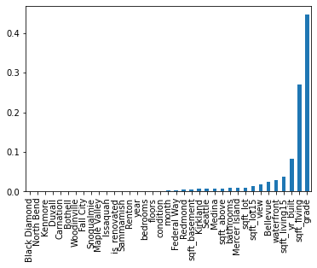
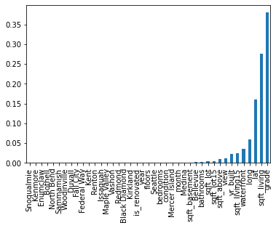
2. DEALING WITH THE EXTRACTED FEATURES:
Through the first part of data studying and analysis, we convert the ZIP code feature that contains numerical zip code values to the city name.
At the step of feature selection and model fitting we found out that the data frame with lat. and long. is more efficient in the prediction model.
convert the yr_renovated column to is_renovated column because most of the houses hasn’t been renovated and the goal is to only know that the house is_renovated or not.
SELECTED FEATURES (USING RF)
SELECTED FEATURES (USING RF)

Slide 9
3. A. FEATURE SELECTION (USING BACKWARD ELIMINATION)
Using backward elimination
Before performing it, we need to prepare our data:
1. We started by converting certain columns to categorical data types. Columns such as 'yr_built,' 'is_renovated,' 'year,' and 'month' were transformed into categorical variables.
2. One-Hot Encoding:
To prepare our data for backward elimination and modeling, we applied one-hot encoding to the 'city' column . One-hot encoding converts categorical variables into binary (0 or 1) format, making them suitable for machine learning algorithms.
3. Backward Elimination:
is a systematic process of selecting the most relevant features while removing irrelevant ones.

Slide 10
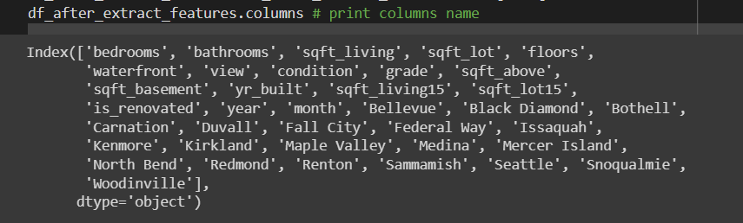
3. A. FEATURE SELECTION (USING BACKWARD ELIMINATION)
Using backward elimination, first and main process of feature selection showed that all columns and features were related to the price –as shown below-.
1
2
3
4
Selecting a significance level
(P-value) of 0.05, to stay in the
model.
Considering the predictor with highest P-value.
Fitting the Model with All Possible Predictors (Except the Removed One)
Removing the predictor

Slide 11
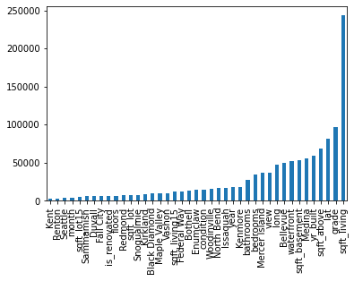
3. B. Feature Selection with LASSO for Model Validation
To assure the result we got, we used “LASSO” to double check the related features, ignoring the coefficient which shrinks to zero, and we also had the result of relation between the price and all other features .
The features selected are the ones that LASSO identified as the most influential in predicting house prices. It automatically eliminated any features whose coefficients shrunk to zero, indicating their lack of significance.
SELECTED FEATURES (USING LASSO)
COEFFICIENTS
FEATURES

Slide 12
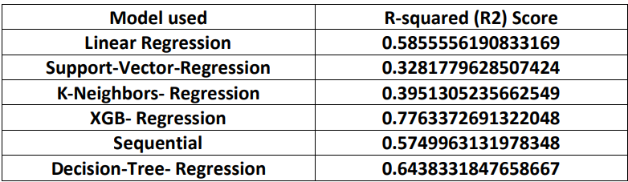
4. MODELS WE USED :

Slide 13
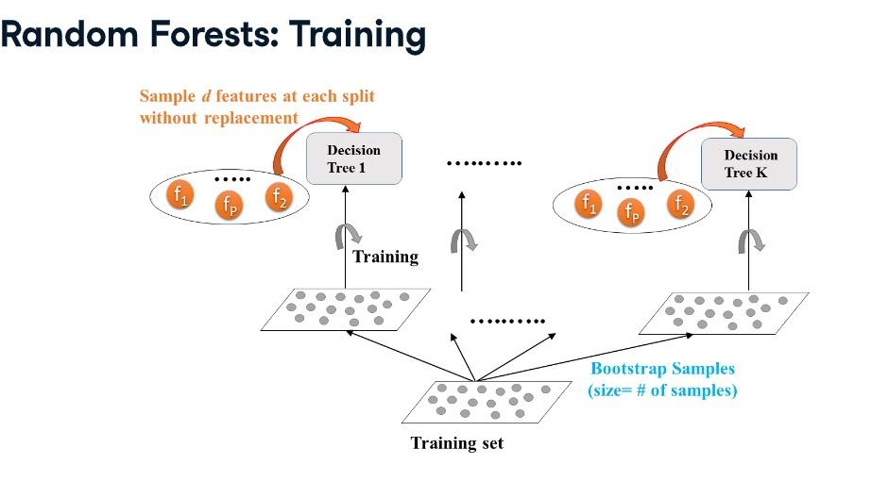
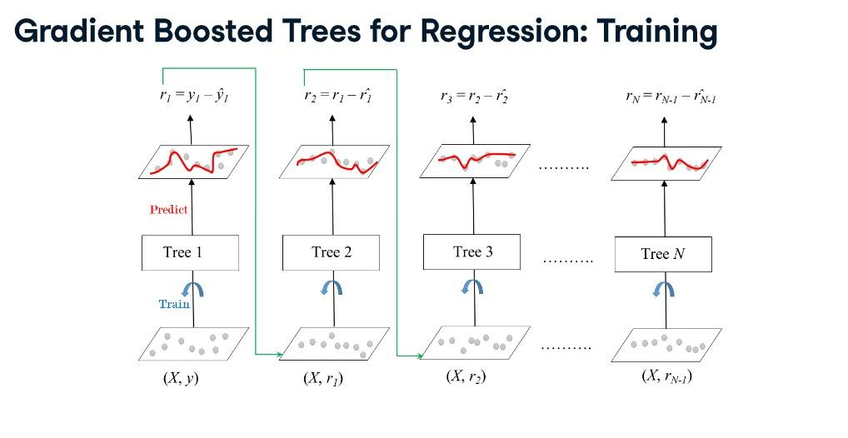
4.1 MODELS WE Choose :

Slide 14



5. A. RANDOM FOREST & GRADIENT BOOSTING FOR MODELING (PRIMARY MODELING) :
RandomForest
GradientBoosting
Train Score
Train Score
Test Score
Test Score
The problem of high overfitting, because as we can see, there is more than 0.05 variation between train accuracy and test accuracy. In other word, our model will work good in the seen data, but badly in unseen data.

Slide 15
6. HYPERPARAMETER TUNING:
RANDOM FOREST
GRADIENTBOOSTING
n_estimators (number of trees)
max_depth (branching)
min_samples_leaf
Step 1- (gradient-wise)
Constant learning rate
Selecting n_estimators
Step 2- (tree-wise)
max_depth (branching)
min_samples_leaf
OPPORTUNITIES

Slide 16

5. B. RANDOM FOREST & GRADIENT BOOSTING FOR MODELING (Tuned Hyperparameters) :
RandomForest
GradientBoosting
Train Score
Train Score
Test Score
Test Score
When we worked on hyperparameters tuning, we avoid the overfitting problem. And the best model was the GradientBoosting

Slide 17
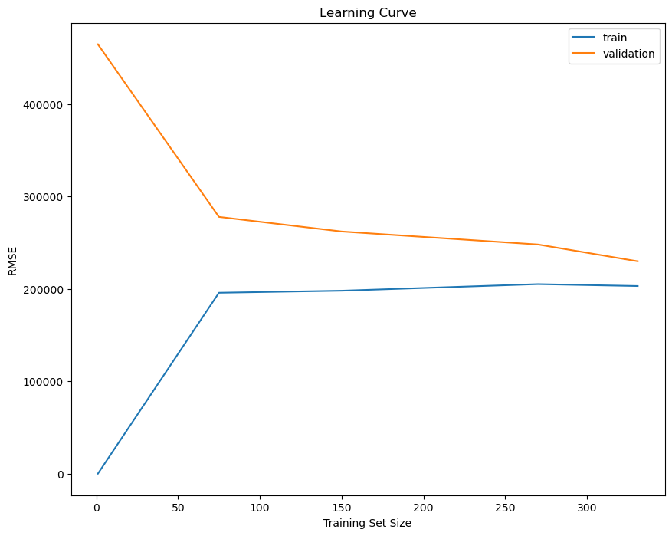
Learning Curve
The learn_curve method will use list of training set sizes [1, 75, 150, 270, 331] to create a learning curve that shows how the model's performance (in terms of root mean squared error, RMSE) changes as the size of the training set increases.
Now we can see we've reduced the error in the validation data. It came at the cost of weakened performance on the training data, but overall it's a better model.
The generalization error is much smaller, with a low number of errors being made. Also, both curves are stable beyond a 250 training set size, which implies that adding more instances may not improve this model much further.

Slide 18
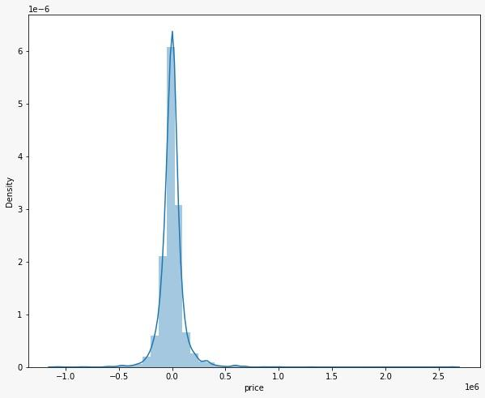
Distributed
residual
The density plot above visualizes the distribution of residuals for our Gradient Boosting Regressor model. Residuals represent the differences between the actual prices and the predicted prices for the properties in our dataset.
x-axis represents the residual values
y-axis represents the density of these residuals
From the plot, we can observe that the distribution of residuals appears to be approximately normal, centered around zero. This is a positive sign, indicating that our model has effectively captured the underlying patterns in the data.

Slide 19

Best Model Evaluation :
Model Results (GB)

Slide 20
7. USER FACING PAGE:
USER INTERFACE PAGE:
Using (Flask) we created user interface webpage, to help the user estimate a price for the real estate.

Slide 21
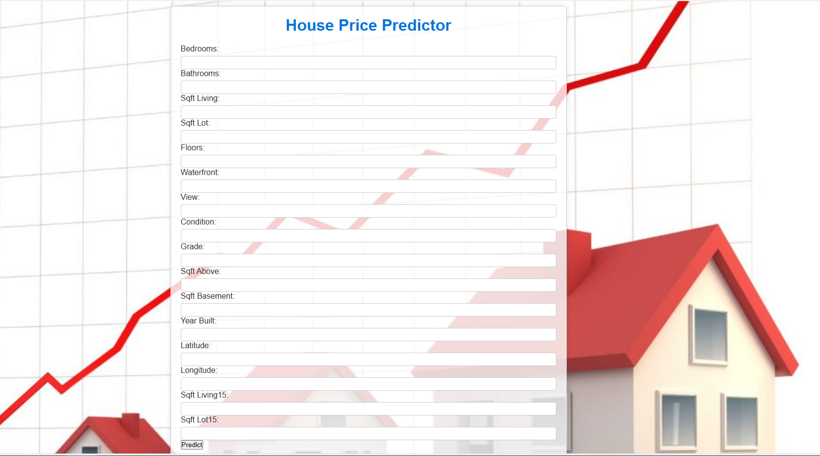
Web Page

Slide 22
THANKS
Does anyone have any questions?

